Slide 1
Assessment 1: Coding Exercise
OUTPUTS
Josh Louis R. Contreras CCL4

Slide 2
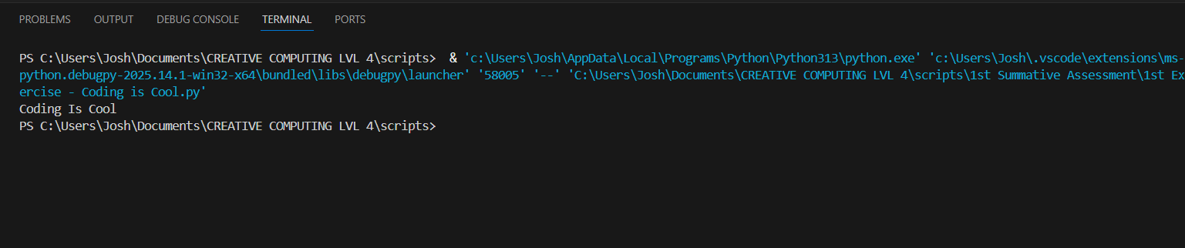
#1st Exercise: Coding is Cool

Slide 3
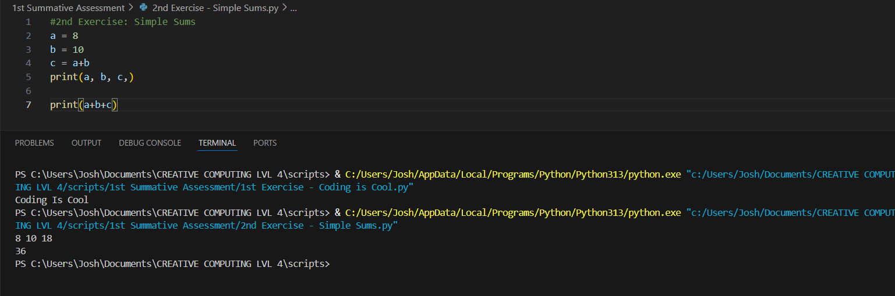
#2nd Exercise: Simple Sums

Slide 4
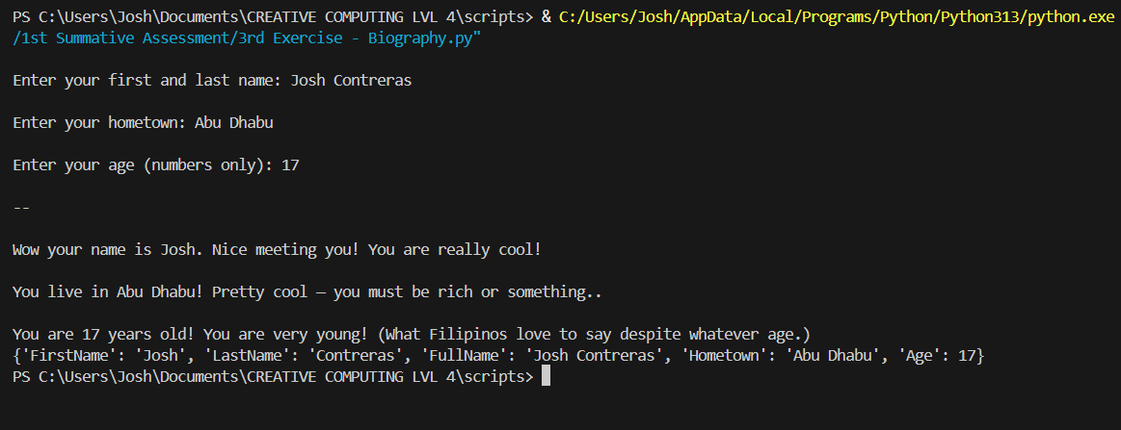
# Exercise 3: Biography

Slide 5
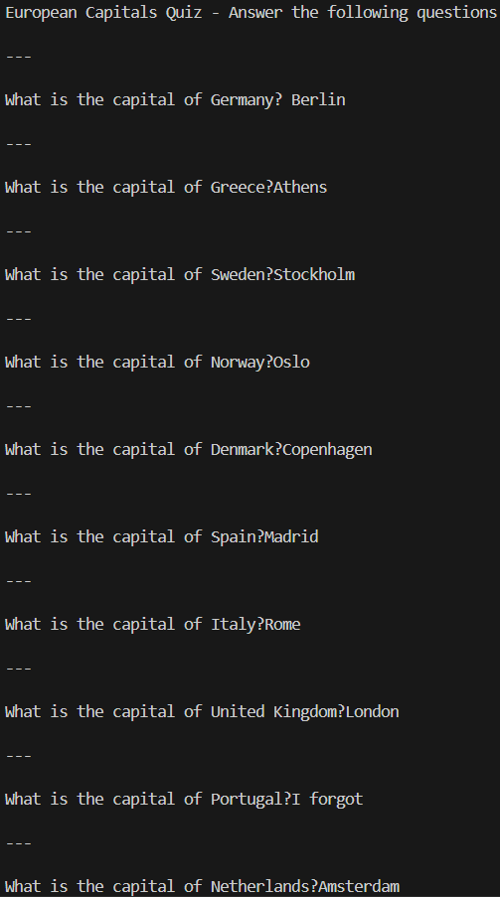
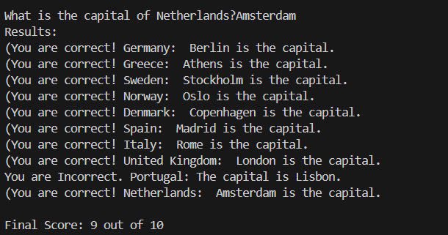
#Exericse 4: Not so primitive quiz!

Slide 6
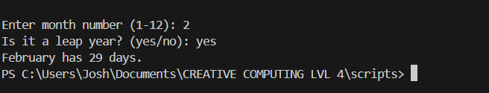
#5 Exercise: Days in a month

Slide 7
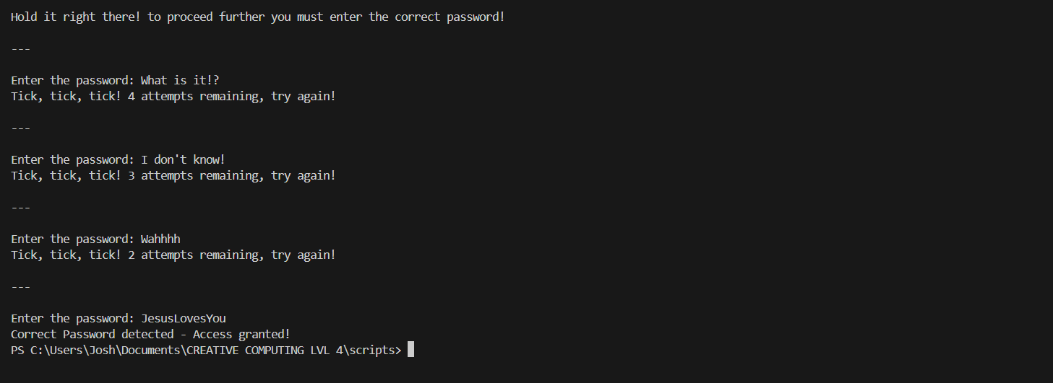
#6 Exercise: Brute Force Attack!

Slide 8
#6 Exercise: Brute Force Attack!

Slide 9
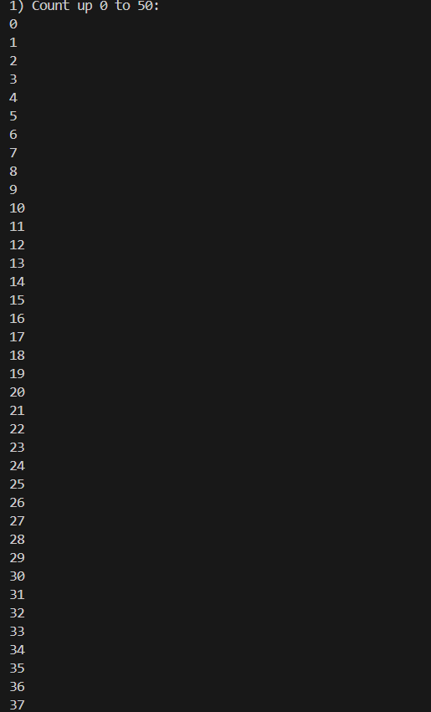
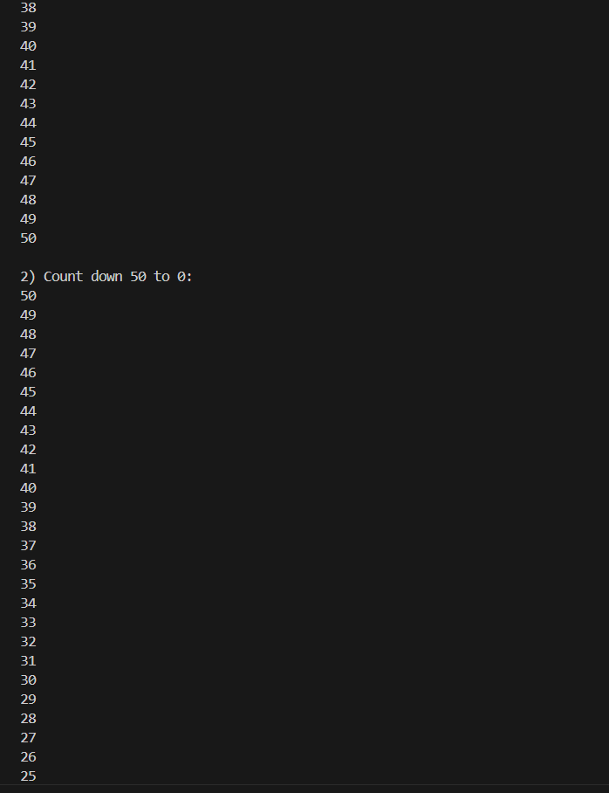
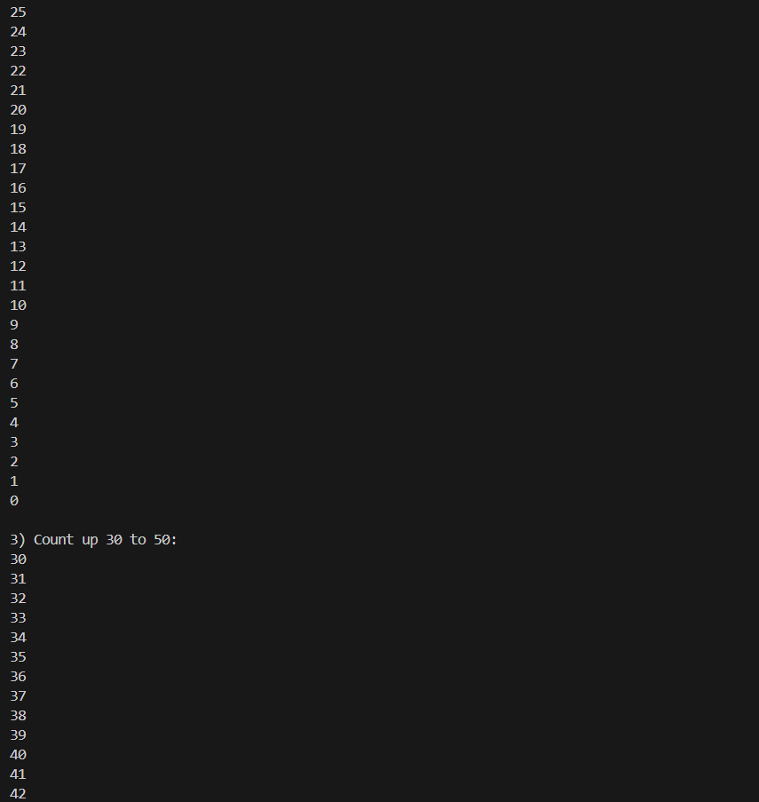
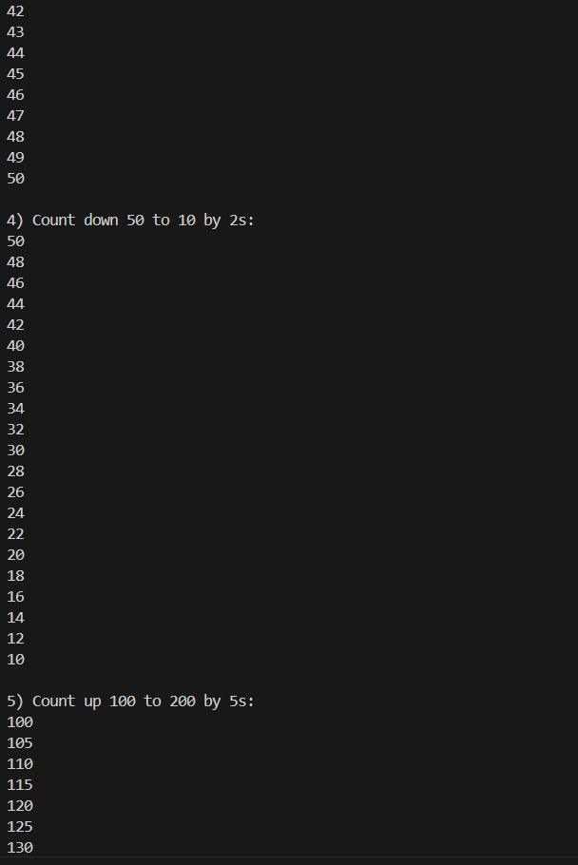
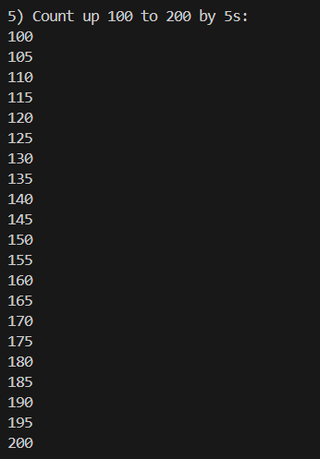
#7 Exercise: Some Counting

Slide 10
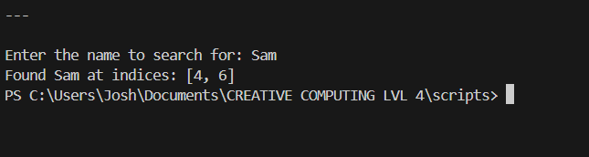
#Exercise 8: Search for Sam

Slide 11
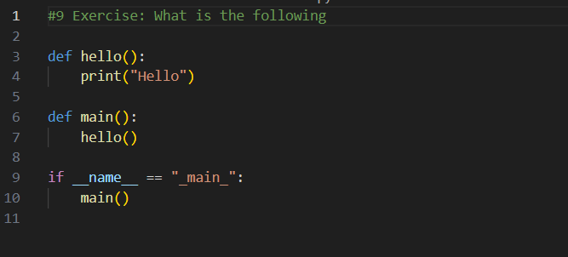

Slide 12
